Slide 1
Science Measurement Tools
9/24/2015

Slide 2
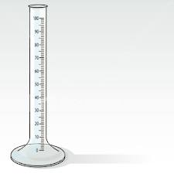
What is the name of this tool?
Beaker
Graduated Cylinder
Pan Balance
Triple Beam Balance

Slide 3
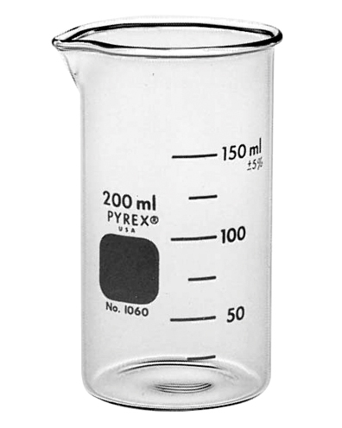
The VOLUME of matter is a measurement of…
Mass
Length
Space
Noise

Slide 4
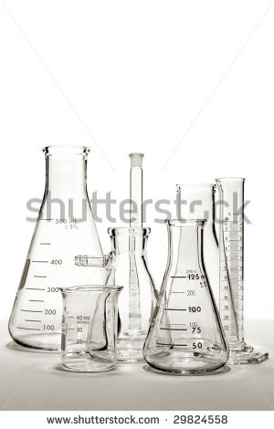
The tool that measures volume MOST accurately is…
A beaker
A graduated cylinder
A cup
Your hand

Slide 5
Volume is measured in which unit?
Milliliters (mL)
Grams (g)
Centimeters (cm)
Pounds (lb)

Slide 6
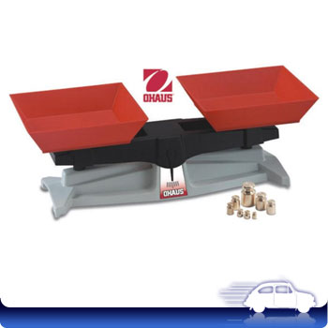
A balance is used to measure…
Weight
Volume
Mass
Height

Slide 7
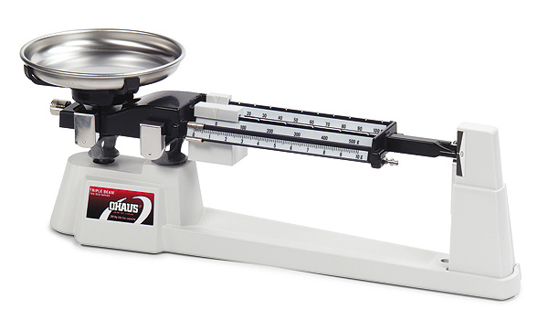
The tool pictured is a…
Pan Balance
Triple Beam Balance
Spring Scale
Balance Beam

Slide 8
Mass is measured with…
Milliliters (mL)
Ounces (oz)
Centimeters (cm)
Grams (g)

Slide 9
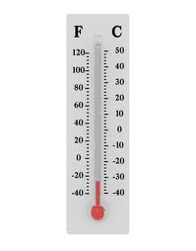
The following tool is used to measure…
Mass
Volume
Weight
Temperature

Slide 10
Science usually measures temperature with which scale?
Fahrenheit
Celsius

Slide 11
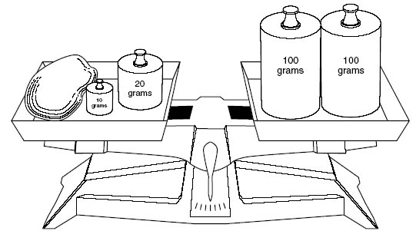
What is the mass of the blue thing in the pan balance?
20 grams
100 grams
200 grams
300 grams

Slide 12
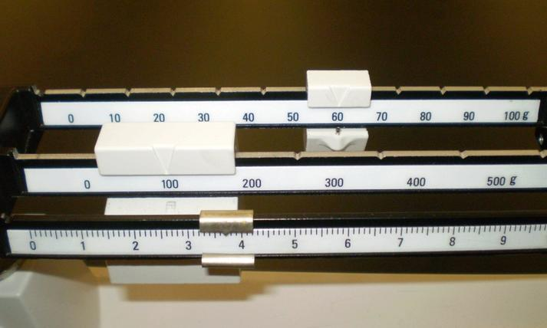
What is the mass on the triple beam balance?
63.7 g
136.7 g
163.7 g
263.7 g

Slide 13
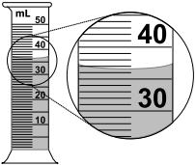
What is the volume?
30 ml
35 ml
36 ml
40 ml

Slide 14
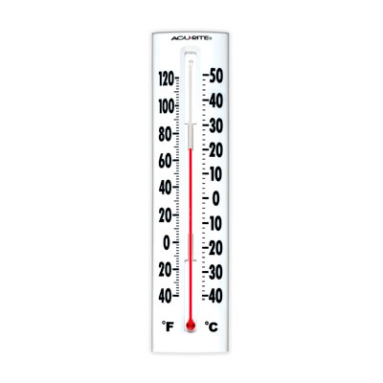
What is the temperature?
20 degrees C
20 degrees F
70 degrees C
70 degrees F

