Slide 1
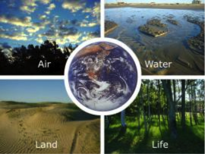
Earth’s Spheres
What spheres can you find?
Image Courtesy of NASA

Slide 2
Your Mission: Look at the satellite image and identify as many spheres that you and your group can see. Write the names of the spheres on your worksheet.

Slide 3
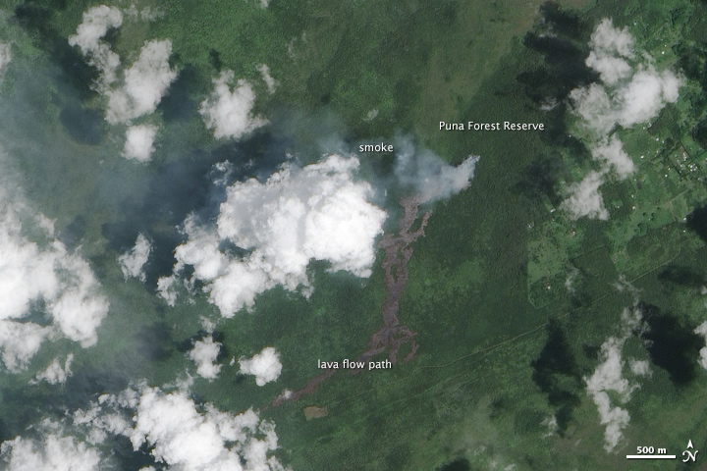
KILAUE‘A LAVA FLOW
Image Courtesy of NASA

Slide 4
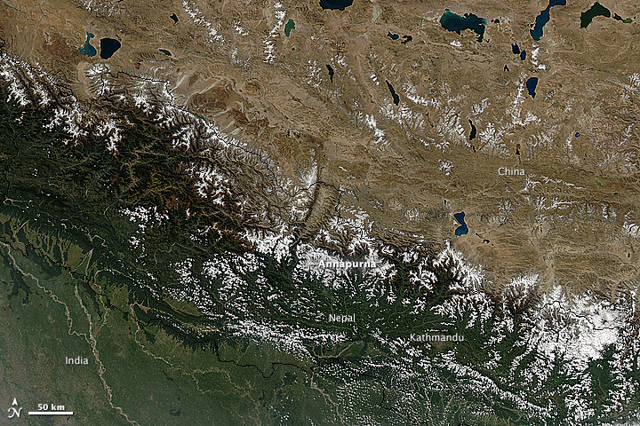
Blizzard
Image Courtesy of NASA

Slide 5
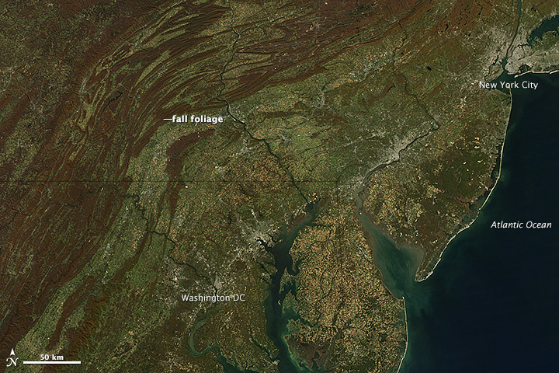
Fall Leaves in the Northeast, USA
Image Courtesy of NASA

Slide 6
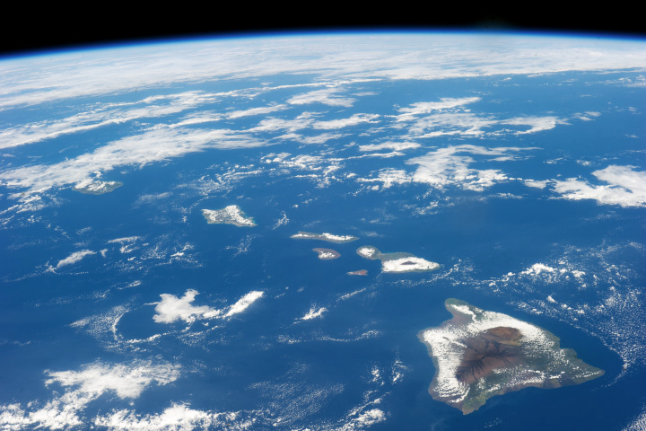
Hawai‘i
Image Courtesy of NASA

Slide 7
References
Allen, Jesse (Photographer). (2014). Volcanic Activity at Kilauea [Photograph], Retrieved April 19,
2015, from: http://earthobservatory.nasa.gov/NaturalHazards/view.php?id=84370
[Connect the Spheres: Earth Systems Interactions]. Retrieved April 19, 2015, from:
http://pmm.nasa.gov/education/lesson-plans/connect-spheres-earth-systems-interactions
Schmaltz, Jeff (Photographer). (2014). Blizzard in Nepal [Photograph], Retrieved April 19, 2015,
from: http://earthobservatory.nasa.gov/IOTD/view.php?id=84585
Schmaltz, Jeff (Photographer). (2012). Fall Colors in the Mid-Atlantic [Photograph], Retrieved April
19, 2015, from: http://earthobservatory.nasa.gov/NaturalHazards/view.php?id=79512
Schmaltz, Jeff (Photographer). (2014). Hawaii [Photograph], Retrieved April 19, 2015, from:
http://earthobservatory.nasa.gov/IOTD/view.php?id=82975

